Slide 1



Agriculture and Rural Development

Slide 2





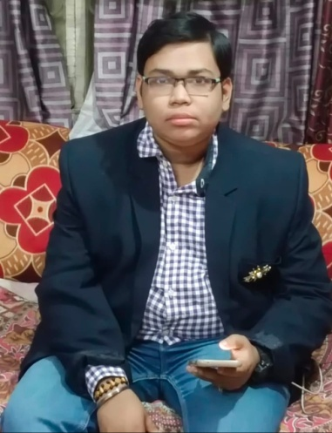
TEAM
Sanghita Mitra
BTech Biotechnology
Ankita Shaw BCA
Joydip Das
BTech Civil
Srinjoy Paul
BCA

Slide 3
Know Our Team Members
Team Member Name | Strength |  | Job Role Assigned for this Project
Sanghita Mitra | Strong Leadership |  | Project Planning
Joydip Das | Having a positive attitude |  | Making PowerPoint Presentation and involvement in project planning
Ankita Shaw | Innovative thinking & technical management |  | Making an app and website
Srinjoy Paul | Good active listening |  | Collecting photos and involvement in project planning

Slide 4
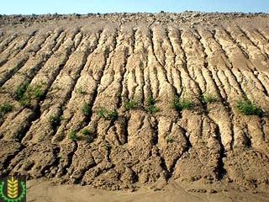
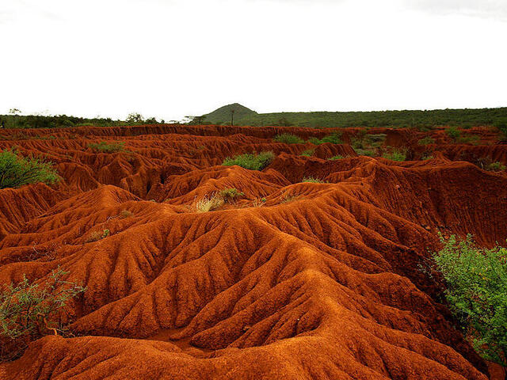
Problem Statement
Many farm owners or government organisations face challenges establishing healthy vegetation quickly and cost effectively on large or uneven terrain. Traditional seeding methods often result in uneven growth, erosion and increase maintenance cost. There is a need for reliable efficient in environmentally friendly solution that can establish lush vegetation in challenging landscapes from promptly and sustainably.

Slide 5

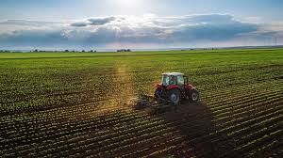

Mission Statement
So our mission is to restore the fertility of land and development by providing eco friendly hydroseeding solutions the deliver lush sustainable vegetation quickly and cost effectively. Innovation integrity and a commitment to environment we came to enhance the fertility, high yield of crops and improvement in rural community

Slide 6
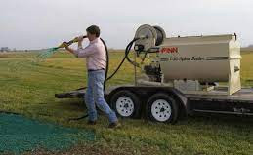
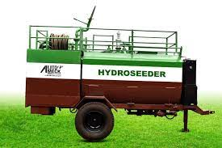
Solution
We can do this with the help of an advanced technique known as hydroseeding. It is a mechanical method of applying sensed, fertilizer and mulch to land in ore step. And the equipment that is used in this method is known as mechanical agitated hydroseeder. 1. Tackifiers can be used for the application to help keep the seed in place 2. And it provides mulching medium around the seed to hold moisture.

Slide 7
Designer business concept (how the project would become financially sustainable) :
Service provision : offering hydro seeding services to control erosion and make it suitable for farming or revegetation project
2. Customization : tailoring hydro seeding mixes based on client means.( Specific mixes, seed types, soil conditions). It allows premium and repeat business
3. Efficiency : it is faster and more efficient than traditional seeding methods. This efficiency enables contractors to take more projects within a given time frame there by increasing revenue potential.
4. Environment benefits: it reduces erosion improve soil health and can there for attract environmental conscious clients who are willing to pay a premium for landscape solution
5. Equipment sales and rentals : besides offering services rent in hydro seeding equipment to other contractors or organizations expense revenue opportunities

Slide 8
Build your business Canvas
customer segment :
● Government agencies : municipalities in environmental agencies for erosion control and land rehabilitation project
B. Value propositions :
● Efficient seeding solution : faster and more effective than traditional seeding methods
● Customer seed mixes : tailored to specific soil types, climate conditions in client preferences
C. Channels :
● Direct sales : website, social media and direct marketing to attract clients
● Partnership : collaborate with landscaping companies and government agencies
D. Customer relationship :
● Personalized service : consultation and seed mix selection and project planning
● Customer support : assistance with post seeding maintenance and trouble shooting
E. Revenue stream :
● Hydroseeding services : one time fees for seeding projects based on area and complexity
● Equipment sales : renting out equipment to other contractors
F. Key resources :
● Hydroseeding equipment : high quality machines for higher efficiency
● Skilled workforce : trained technicians for operating equipment and management project.

Slide 9
SWOT ANALYSIS
A. Strengths :
● Environmentally friendly : it uses high-quality seed and mulch that promote soil conservation and prevent erosion.
● Cost affective : generally more affordable than traditional seeding methods due to faster application and reduced labor cost
B. Weaknesses :
● Weather dependency : application effectiveness can be hindered by advertise the conditions like heavy rain or extreme temperature
● Skill intensive : required strain technicians for proper application and management
C. Opportunities :
● Government contract : opportunities to secure contracts for public infrastructure projects in land rehabilitation
● Growing environmental awareness : increasing demand for sustainable landscaping
D. Threats :
● Weather threats : application effectiveness can be hindred by adverse whether conditions like heavy rain or extreme temperature
● Price competition: price wars with competitors undercutting each others pricing affecting profitability.

Slide 10
Access and plan for scalability:
A. Market research and demand analysis:
● Understand current market trends and demand for hydro seeding services
● Identify potential growth areas such as new environmental or landscaping market
B. Invest in technology and equipment:
● Upgrade equipment to improve productivity and capability
● Explore technological advancement such as GPS mapping for precise application and automatic systems for mixing and spraying
C. Expand service offerings:
● Diversify services to cater to a broader range of clients
● Offers specialized solutions based on client needs and project requirements D. Monitor and adapt :
● Continuously evaluate business performances against goals and adapt strategies as necessary
● Stay agile and responsive to market changes in opportunities for growth

Slide 11
Build a prototype (MVP)/ start a pilot :
A. Define core features :
● User interface : developer simple user friendly interface for customers to request hydroseeding services
● Service description : clearly outline what hydroseeding benefits and process details
B. Backend functionality :
● Service request form : create a form for customers to enter project details
● Cost estimation tool : implement a basic calculator to provide your estimations based on project inputs
C. Admin dashboard :
● Project management : a dashboard for admins to view incoming request, manage bookings and assign tasks
● Communication : integrated messaging or notification system to communicate with customers
D. Marketing and customer acquisition :
● Landing page : create a landing page explaining hydroseeding benefits and services ..● Online ads : run targeted ads on platforms like Google ads of Facebook to drive traffic.

Slide 12






EXPERTS/ ADVISORS
SUPPLIERS
Biotechnologists and soil microbiologists
OUR PROJECT
Industries and factories
PARTNERS
CUSTOMERS
Biotech firms
Small and Large scale Farmers
STAFF
FUNDERS
Crowdfunding, Business incubators, Bank loans, Venture capital and angel investors.
Software engineers, app developers, delivery boys, cashier etc.

Slide 13
Thankyou

